Slide 1


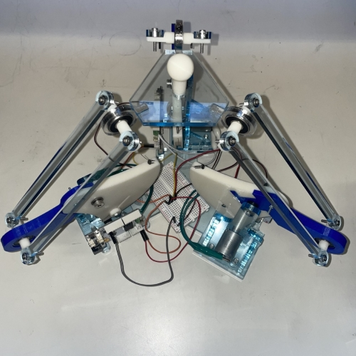
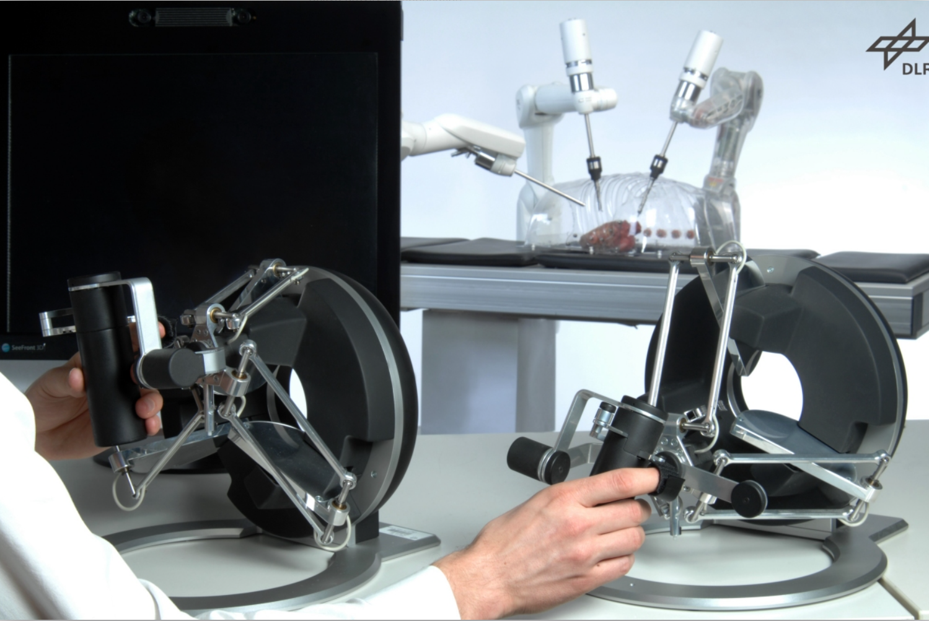
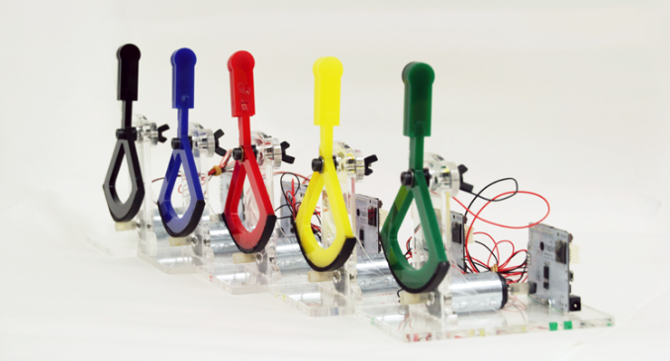
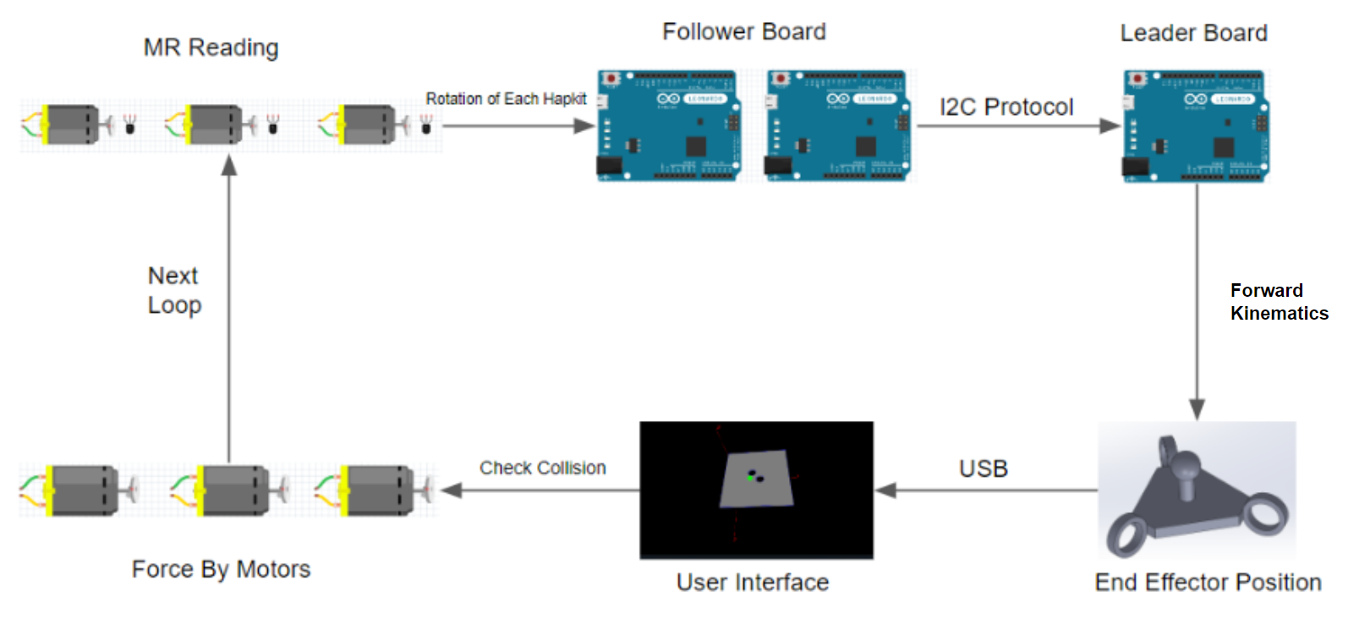
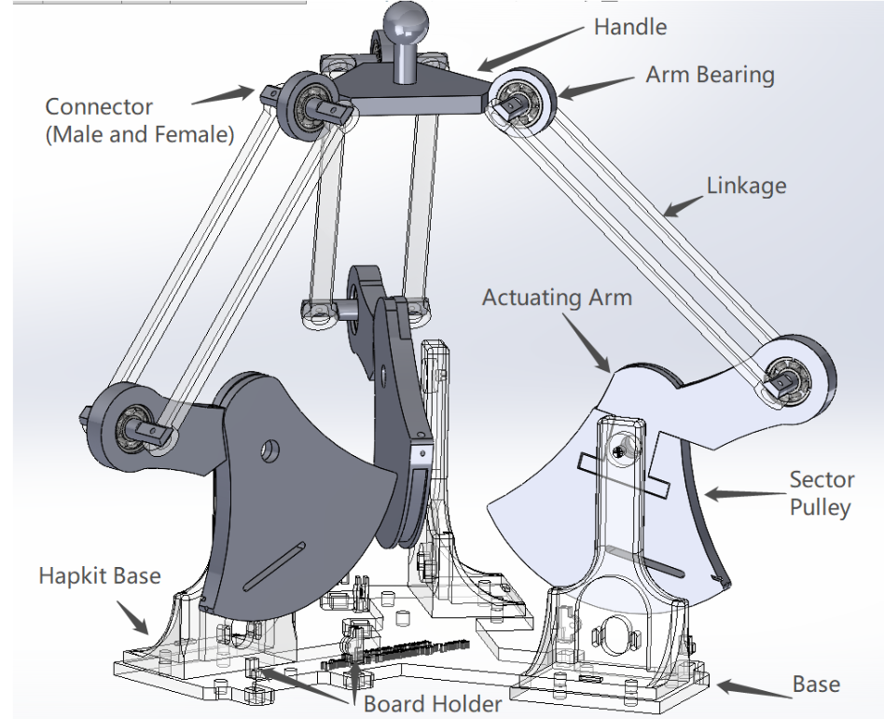
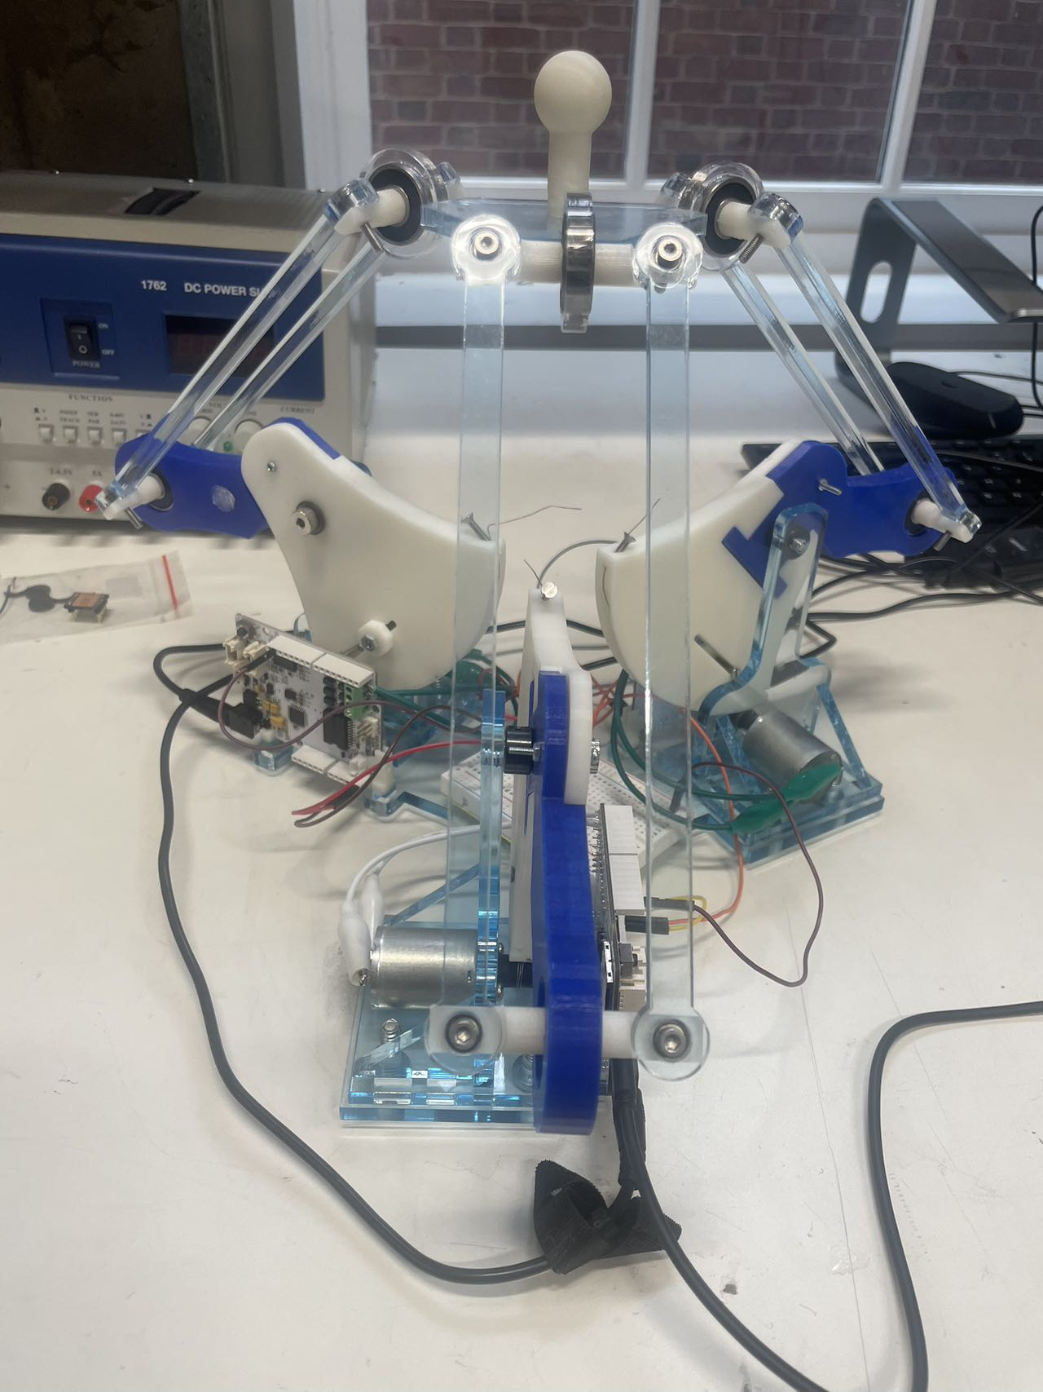
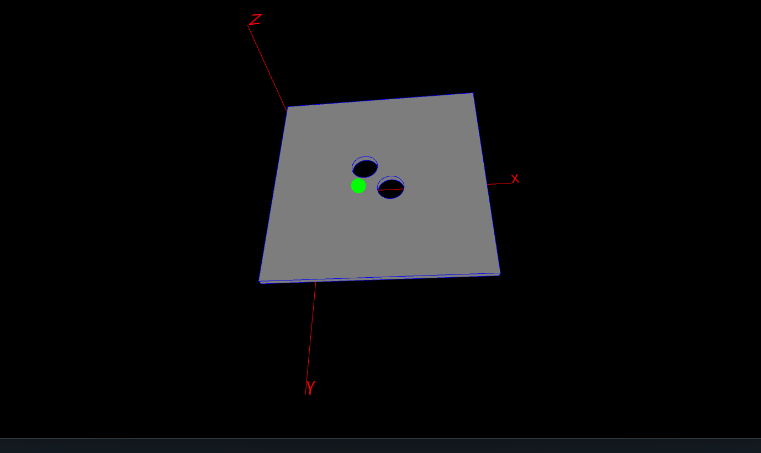
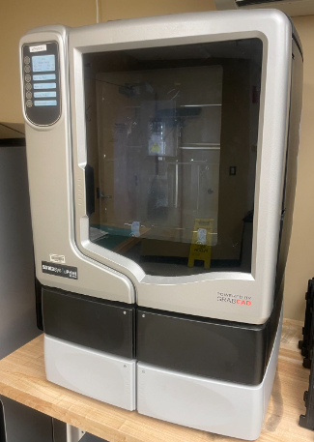
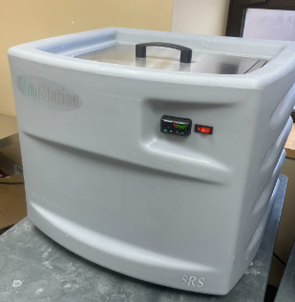
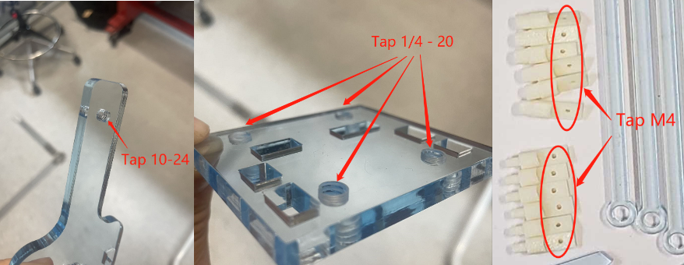
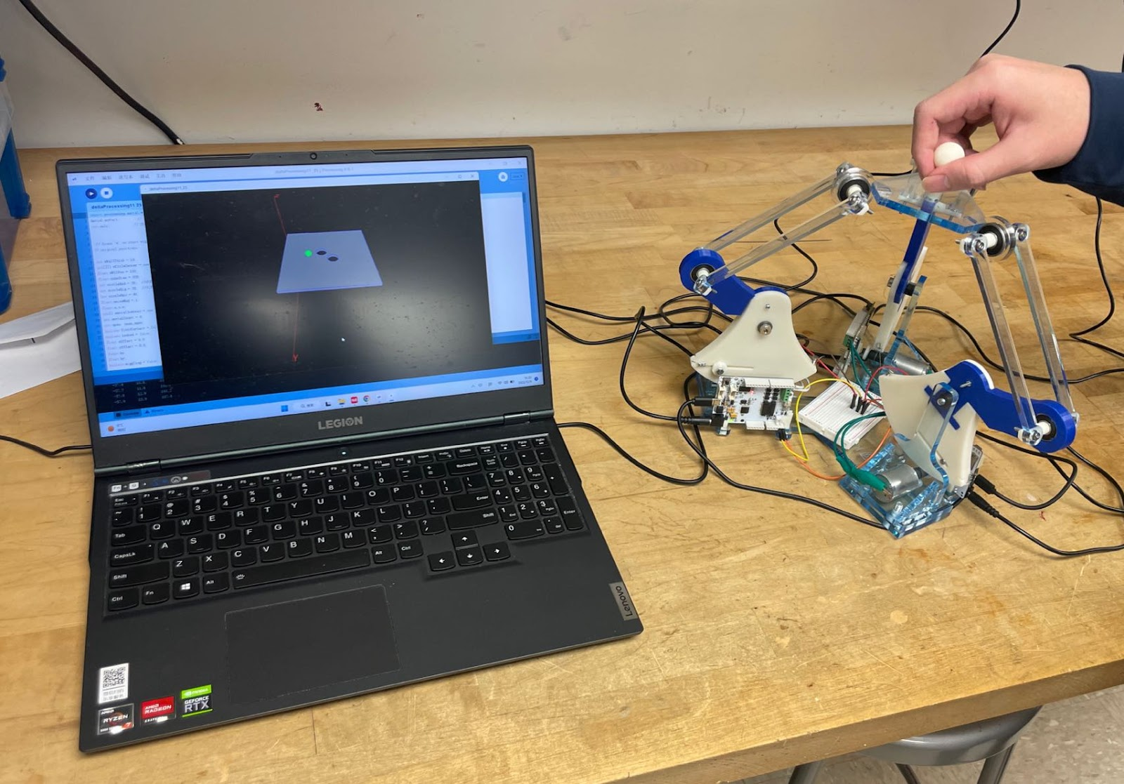
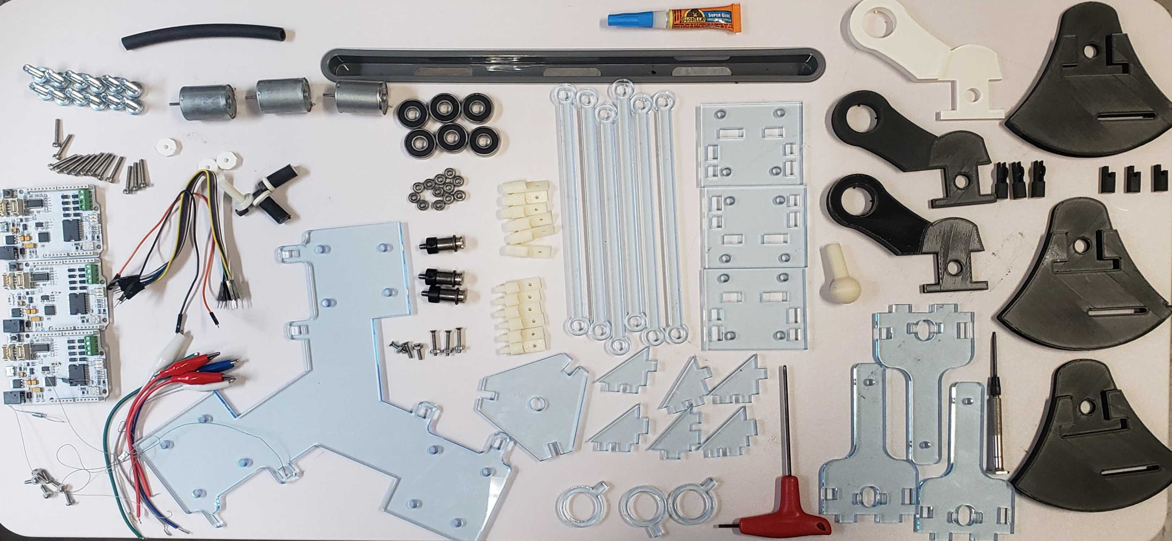
3D Hapkit: A Low-Cost, Open-Source, 3-DOF Haptic Device Based on the Delta Parallel Mechanism
Han Zhang¹, Jan U. Bartels², and Jeremy D. Brown²
¹ Biomedical Engineering, Johns Hopkins University, Baltimore, MD, USA
² Laboratory for Computational Sensing and Robotics, Johns Hopkins University, Baltimore, MD, USA
Background & Motivation
Haptic interfaces, including virtual reality and teleoperation, are becoming essential to modern human-computer interfaces.
There is an increasing need for affordable multi-DOF haptic devices to expose students to these interfaces due to the growing number of haptics course being offered.
Prior Work: Martinez et al. developed the Hapkit, an open-source programmable 1-DOF haptic feedback device, which is widely used in haptic education[1].
Goal: Develop a low-cost, programmable, 3-DOF haptic device for education applications:
Enable multi-DOF haptic rendering in three-dimensional space.
Provide an affordable and realistic haptic interface for students.
Showcase the integration kinematics, mechatronics, rapid prototyping, and hands-on skills into learning experience.
Create a smooth, engaging educational experience for understanding complex concepts and gaining practical skills.
Teleoperation with Haptic Device
Hapkit
3D Hapkit
https://www.forcedimension.com/products
https://hapkit.stanford.edu/about.html
Hardware and Prototyping
Electronics & Software
System Description
To achieve the haptic reproduction capability, we implemented the delta parallel mechanism as the foundation for our 3-DOF Hapkit combined with original capstan transmission. In order to optimize the workspace of this mechanism, we strategically rotated the original handles by 50 degrees and securely attached three Hapkit devices onto an acyclic board, evenly spaced 120 degrees apart.
Compared with series mechanism:
High load capacity
Better Stability
High accuracy of end-effector position
Electronics of the 3D Hapkit contain three original Hapkit 3.0 boards:
Custom PCB with build-in microcontroller, motor driver, microSD card port and soldered magneto resistive sensor.
Configuration:
One-leader, two-follower setup, communicated via the I2C protocol.
Functionality:
Follower board deliver the MR reading and generate torque
Leader board computes end effector configuration and deliver desired force as torque output.
Assembled 3D Hapkit
3D Hapkit in Solidworks
Virtual Render & Demonstration
Manufacturing and Prototyping
3D Hapkit were mainly made of laser-cut acrylic pieces and 3D printed parts. Material costs for one of our devices, including electronics, purchased hardware, and material, is less than $300. However, if the costs of the Hapkits is factored out, the cost of 3D Hapkit is less than $80.
Dependency:
FDM 3D Printer with ABS filament/Soluble Support Material (ABS Usage < 300 g)
Laser Cutter (Universal Laser System-VLS6.60) with ¼ inch acrylic board (Acrylic 12' * 24')
Metric Tap and Die Set(1/4’ – 20 & 10 – 24 & M4)
Virtual Render:
Users interact with a virtual environment rendered in real-time using Processing.
The virtual environment consists of 3D objects and interactive element
Visual feedback is provided through a dynamic and responsive display.
Demo:
User can grab the end effector of the 3D Hapkit.
Green cursor tracks the movement in the virtual environment.
3D Hapkit renders the realistic kinesthetic interaction when cursor encounters virtual objects or pass holes(shown in grey).
3D Hapkit accurately reflects the forces and resistance encountered in the virtual environment, enhancing the sense of presence.
Simulation in Processing
FDM Printer(uPrint SE)
Washer(Remove Support)
Parts Needed Postprocess
Demo: 3D Virtual Wall
Conclusion and Future Work
All design files, circuit schematics, and code are open source and can be accessed at our GitHub page (https://github.com/HanZhang206/3D-Hapkit)
Inversed dynamic model will be implemented to generate force in various direction
In Fall 2023, we aim to deploy the 3D Hapkit in the Haptic Interface Design course at Johns Hopkins University as an educational tool, enabling students to gain hands-on skills and fundamental knowledge in haptics.
Unassembled 3D Hapkit
Acknowledgement
Reference
The development and implementation of the 3D Hapkit was supported by the Haptics and Medical Robotics(HAMR) Laboratory. Special thanks to Dr. Jeremy Brown for this guidance and invaluable advice.
The 3D Hapkit was made possible by the Hapkit: https://hapkit.stanford.edu/about.html
Guanyang L., Yinong C., Zheng X., Xuda G. GA\SQP optimization for the dimensional synthesis of a delta mechanism based haptic device design. Robotics and Computer-Integrated Manufacturing 51, 73–84 (2018). https://doi.org/10.1016/j.rcim.2017.11.019.
Orta Martinez, M., Nunez, C.M., Liao, T., Morimoto, T.K., Okamura, A.M.: Evolution and analysis of hapkit: An open-source haptic device for educational applications. IEEE Transactions on Haptics 13(2), 354– 367 (2020). https://doi.org/10.1109/TOH.2019.2948609

